Slide 1
Week 02, Day 01
Git, the Terminal, and HTML Tables
CodeSLO 2018

Slide 2
The File System

Slide 3
The File System, Demystified
As technology professionals, it is important that you become very familiar with how computers work. A basic, yet essential, skill that you’ll need to master is navigating a computer’s file system, both in a GUI and in the command line or terminal.
In this class, we’ll look at navigating the Windows File Explorer and the MacOS Finder. It’s assumed that our Linux users are comfortable with the GUI of their chosen desktop environment.
Then, we’ll look at the Windows command line and the MacOS terminal, which is very similar to the Linux terminal. The terminal commands we’ll use in class will all function in Linux, as well.

Slide 4
Windows Explorer

Slide 5
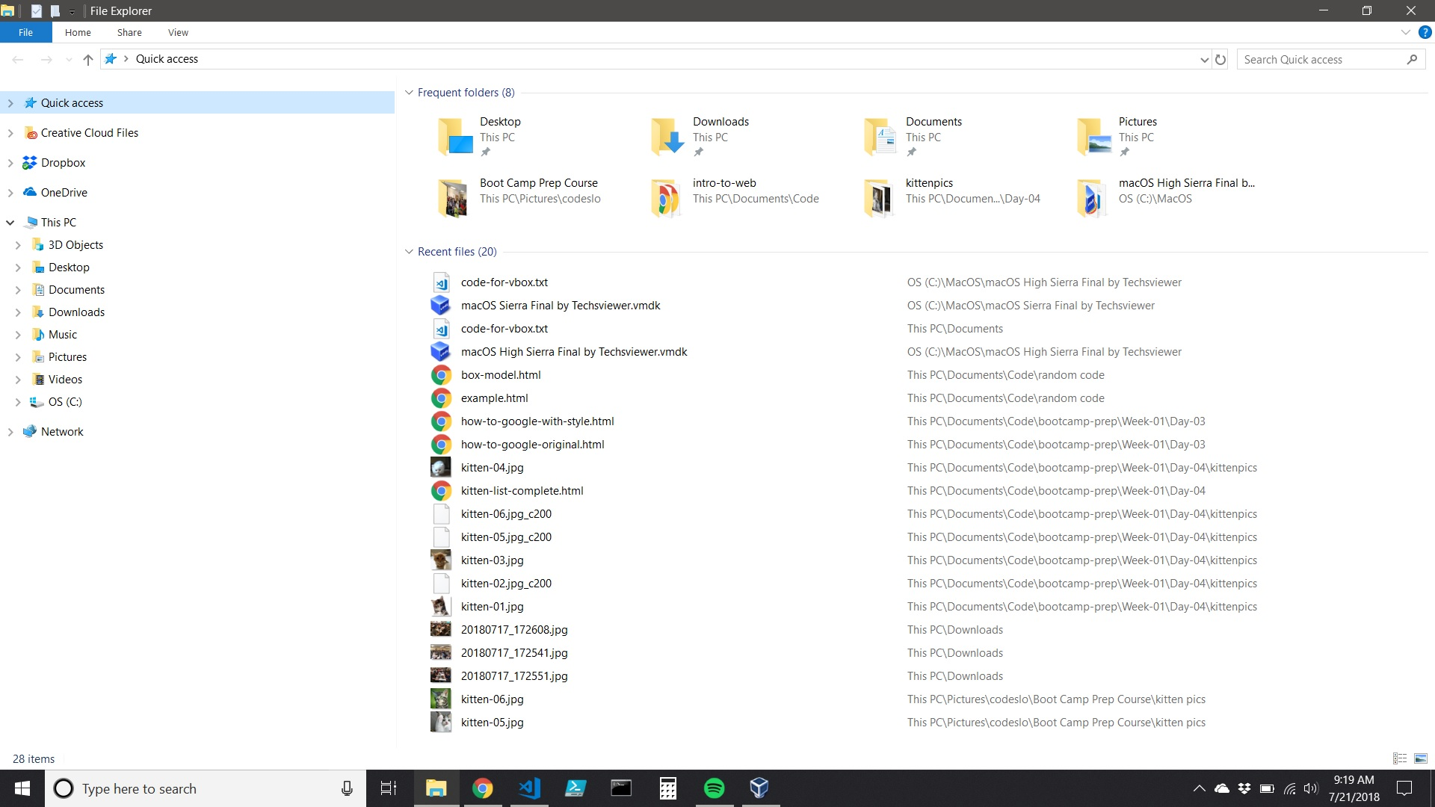

Slide 6
The Windows File System
The Windows File System starts at the root, or the highest directory of a file system. The root does not have a parent directory.
On a PC, the root of the hard drive is usually C:
Inside the root directory are many directories, which are often called folders. Each directory contains a variety of subdirectories, or subfolders.
A few important directories include the Program Files and Program Files(x86) directories, and the Users directory

Slide 7
Exercise for Windows Users: Explore Explorer
For our Windows PC users, open Explorer and navigate around.
Be sure to look in both the Program Files and Program Files(x86) directories
Be sure to look in the Users directory. Can you find your Documents folder?
Once you’re down into the Users directory, can you navigate back to the root? There are multiple ways to do this.
BE CAREFUL. You can’t hurt your computer just by looking around, but if you start right-clicking and moving or deleting files you could easily break programs. They won’t be able to find the assets they need

Slide 8
MacOS Finder
The Finder is the equivalent of the Windows Explorer. It is arguably a better tool than Explorer for casual users, but isn’t as straightforward for developers.
When you look in Finder, what you’re really looking in is the equivalent of one of the User directories in Windows or Linux.

Slide 9
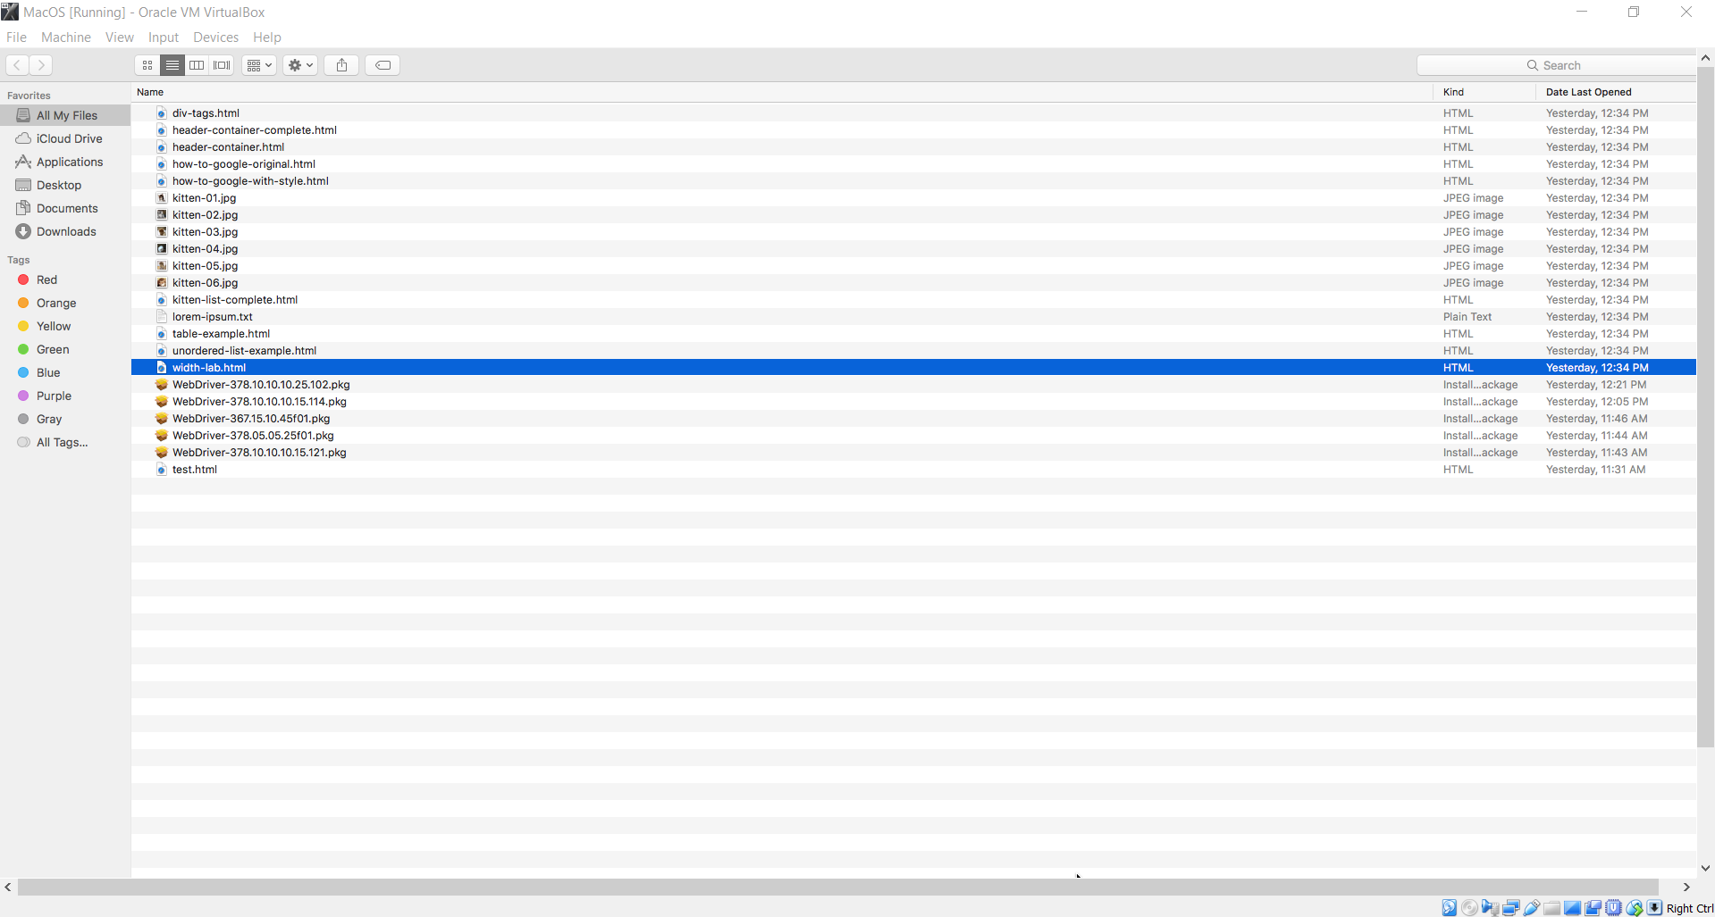

Slide 10
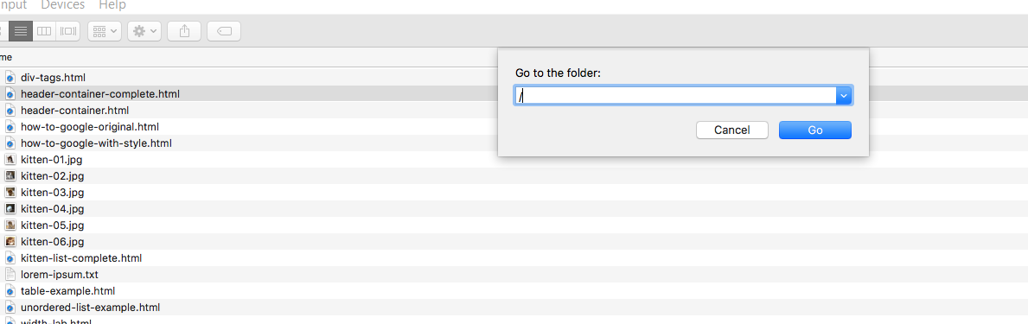
Navigating to Root in Finder
A Mac’s file system is very similar to both the Windows and Linux file system in that there is a root directory, which contains a variety of subdirectories.
To navigate to your root directory, use the command + shift + G keyboard short cut, and enter “/” without the quotes.

Slide 11
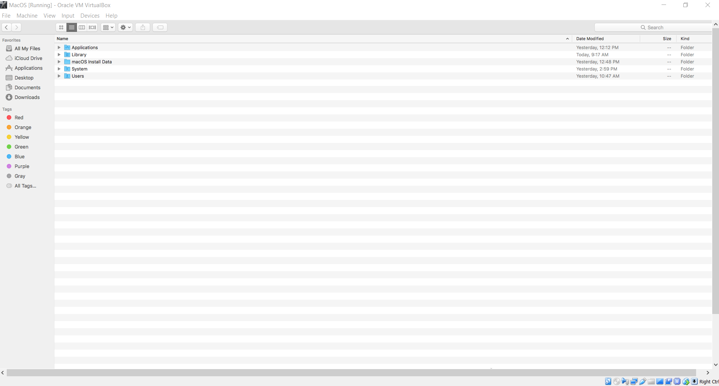

Slide 12
Exercise: For MacOS Users - Navigate the File System
Using Finder and command + shift + G go to your root directory
Navigate your file system. Be sure to check out the Applications and Users directories
Be careful. Although Mac and Linux are more secure operating systems than Windows, it is still possible to bork ** your system by deleting or moving the wrong files.
** bork is a “technical” term meaning to break part or all of your system.
*** until you’ve accidentally borked and then recovered your system a couple of times, you can’t really say you’re a computer expert. However, try not to do it now.

Slide 13
The Windows Command Line
The Windows 10 Command Line can be opened from within Visual Studio Code by opening a terminal window.
Outside VS Code, it can be opened by typing cmd into the search area of your task bar.
It’s a good idea to pin the command line window to your taskbar for quick access.
The command line window can be opened either as a normal user or as an administrator. The administrator has greater power. Thus, be extra careful when using the CLI as an administrator.

Slide 14
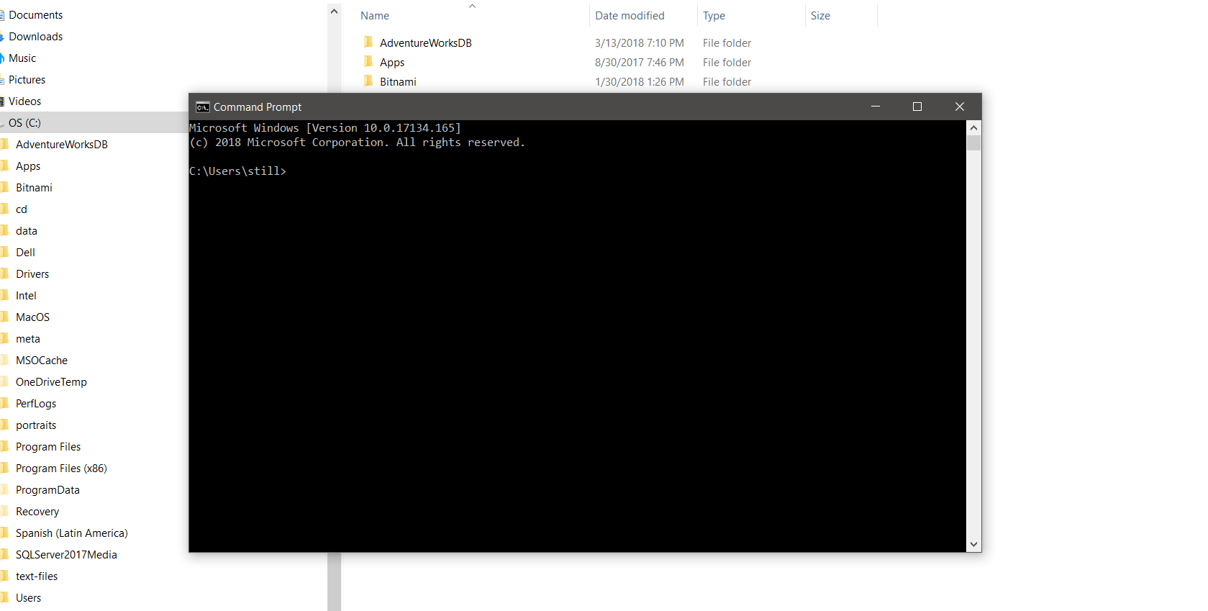

Slide 15
Navigating the Windows File System with the Command Line
Using the command dir will show you the files and subdirectories of your current directory.
Using the cd command will allow you to change your current directory
Using cd .. will take you up one level in your file system. For example, it will take you from C:\Users\[your user name] to C:\Users
Using cd \ will take you to your root directory
You can go directly to a given directory by entering its full path. Example: cd \Users\[your user name]\Documents\code

Slide 16
Dealing with Spaces in Directory Names
Windows allows directory names to contain spaces, but this makes them a little tricky to navigate to.
You can do it by enclosing a path name that contains spaces in double-quotes
For example, to navigate to a directory called StarCraft II in a users Documents directory, we’d use
cd "\Users\[user name]\Documents\StarCraft II"

Slide 17
Windows / vs \
In the Windows CLI, directories and subdirectories are described using a \.
However, in an effort to become more compatible with Linux and MacOS, the Windows CLI will also accept a forward-slash.
Thus, cd \Users\[user name]\Documents and cd /Users/[user name]/Documents are functionally equivalent, at least as far as navigating the file system goes.

Slide 18
Demo: Navigating the Windows File System with the CLI
In this demo we’ll use the CLI to navigate the Windows file system

Slide 19
Exercise: Windows users practice navigating the file system
There’s nothing like hands on practice. Just as you practiced navigating in explorer, now do the same in the command line
Use the dir command to see what files and folders are in each location
Use cd.. To move up the directory tree and cd \ to quickly go back to the root directory

Slide 20
Navigating in the Mac and Linux Terminal
In a Unix-based terminal, the root directory is indicated by a $ symbol.
The equivalent to the Windows dir command is ls (short for ‘list’). It will show you the files and subdirectories of your current directory.
Using the cd command will allow you to change your current directory
Using cd .. will take you up one level in your file system. For example, it will take you from $/System/Library to $/System
Using cd / will take you to your root directory. You can also navigate to a folder directly by entering the full path of that folder, just like in Windows.

Slide 21
Demo: Navigating in a Terminal
Watch this demo of basic navigation on a Linux terminal. The commands used for navigating a Mac terminal are identical, but the file structure itself is different.

Slide 22
Exercise: Mac and Linux users - navigate using the terminal
Practice makes better!
When creating or editing files, Mac and Linux users may run into permissions issues. This is a feature of your OS, not a bug. This built-in security is part of why Mac and Linux systems are more resistant to viruses than Windows computers.
Permissions issues can be solved by use of the sudo and chown commands, as well as other commands. These are worth learning but beyond the scope of this class.

Slide 23
Git

Slide 24


Slide 25
It’s going to be fine. Really.
We’ve had a few issues with Git in class, but they stemmed from not really understanding the tool.
Today, we’re going to slow down a bit and go over a few, basic git commands.

Slide 26
First, Let’s Create Some Folders
We did this a little last week, but we’re going to do it again today.
We’re also going to standardize the way we’re doing this. Please create your folders as directed, so we can all have the same experience.

Slide 27
Exercise: Create the CodeSLO folder
Open Explorer or Finder on your computer
Navigate to the Documents directory (not Desktop on anywhere else.)
Create a new folder called codeslo

Slide 28
Create the mycode folder
Inside your codeslo directory, create a new subdirectory called mycode.
Mycode is where you’re going to put all the code that you create in class.
Inside mycode, create eight new subdirectories, called Week-01, Week-02, Week-3, etc.
Copy all the code and exercises you created (and only the ones you created) in class last week, and copy them into the Week-01 subdirectory

Slide 29
Get ready to clone...
Here’s the tricky part. Please be careful to follow directions exactly
Open Visual Studio Code
Open your codeslo folder
Open your terminal and verify that you are in the codeslo folder
If you’re not in the codeslo folder, or if you’re in your mycode subdirectory, use the terminal to navigate to the correct directory.
Please verify with your neighbors at your table that you are in the codeslo folder, not your mycode folder or any other folder.
Please raise your hand if your table isn’t sure

Slide 30
Clone the source code folder
From your codeslo directory, enter the following command into your terminal
git clone https://github.com/codeslo/bootcamp-prep
You should see a new folder called bootcamp-prep appear in your codeslo directory. It will have all our source-code to date inside it.

Slide 31
What we just did
We now have a directory called codeslo that lives in our Documents directory
Codeslo has two subdirectories called bootcamp-prep and mycode
Bootcamp-prep is only for source-code. We won’t be creating any new folders or files in that directory, save by use of the git pull command.
Mycode is only for code that you create. We won’t be pulling anything from Github into that folder

Slide 32
Git init
Git init is a command used to initialize Git source control in a given folder. That source control will then track changes to that directory and any subdirectories it has. It will not track changes to any parent directories.
As far as Git is concerned, whatever folder Git init is called in is the root of your project. It doesn’t look higher up than the root.

Slide 33
How this relates to the CodeSLO folder
In the codeslo directory, we actually don’t have Git initialized. This is correct.
We only have Git initialized in bootcamp-prep. This is because when we cloned that file, it came with its git files intact.

Slide 34
Testing to make sure we have everything correct
In your terminal, make sure you are in the codeslo directory, and not any of your subdirectories.
Run the following command: git pull
You should get an error. This is because git isn’t initialized in this folder.
We want to see this error. It means you don’t have git in the wrong place
If you did not see an error, raise your hand.
fatal: Not a git repository (or any of the parent directories): .git

Slide 35
Exercise: Now we navigate
Using your terminal, cd into your bootcamp-prep subdirectory
Run git pull from that folder
You should see a message that says you’re already up to date.
This means the pull worked correctly! This is what we want. It means you can update your source code whenever you need to.
Already up-to-date.

Slide 36
One more test...
Using your terminal, navigate to your mycode subdirectory
Run git pull again.
You should see the same error you saw in the codeslo directory.
This is because we do not have git initialized in this folder, which is what we want!
fatal: Not a git repository (or any of the parent directories): .git

Slide 37
Removing Git
Sometimes you just accidentally run a git init in the wrong directory. Initializing git in a directory like Documents or other major directories can be a real problem.
Luckily, Git is easy to remove.
When you initialize Git, it creates a hidden folder in that directory called .git
Just delete this file, and git is removed from the directory. Problem solved.
If you decide you want Git back, just run git init again.

Slide 38
Check in and break
Enter the WotD and then back in five...

Slide 39
HTML Tables

Slide 40
Tables
Tables are one of the most useful types of HTML elements, because so many types of data are easily displayed in tables.
Contact Lists
Event Schedules
Guest Lists
Inventory
etc

Slide 41
Creating Tables
Tables are enclosed by <table> tags.
Tables are divided into rows and columns.
Rows are created in HTML explicitly.
Columns are implicit. There is no tag for them
The top row of a table is usually defined as a table header with the <th> tag on each column.

Slide 42
<table>
<tr class="table-head">
<th>Last Name</th>
<th>First Name</th>
<th>Phone Number</th>
</tr>
<tr class="light">
<td>Blo</td>
<td>Joe</td>
<td>707.482.2123</td>
</tr>
</table>

Slide 43
table{
width:30%;
margin:auto;
border:1px solid gray;
font-size:20px;
}
td{
border:1px solid gray;
padding:5px;
}
.table-head{
color:white;
background-color:seagreen;
font-weight:bold;
}

Slide 44
A note on striped tables
In the example today, we used the class “dark” to create alternating light and dark rows. This is a very common way to render tables.
There are better ways to do it! For example, we might use the front-end framework Bootstrap to create striped tables, or we could use JavaScript to assign the appropriate classes dynamically when the page loads.
But that’s all for later. For now, we’ll have to type our classes in manually.

Slide 45
Exercise: Event Schedule
Create a new file called event-schedule.html
Add a Doctype declaration, head, and body sections
Add a table for a fictional hackathon that includes the following events and times
Welcome: 9am
Setup: 10am
Hack Session: 1030am
Lunch: 12pm
Hack Session: 1230pm
Presentations: 6pm
Awards: 8pm

Slide 46
Exercise: Event Schedule (cont)
Now, style your event schedule page
Create header and container divs
Style the table-head row
Make your table rows striped for readability
Center your page content (not the header)

Slide 47
External Stylesheets

Slide 48
Time to Externalize
Until now, we’ve been styling our pages using internal stylesheets. While that can work for an individual page, internal stylesheets don’t scale well to multi-page sites.
Also, there is an idea in web development called the separation of concerns. Separation of concerns dictates that we keep out HTML, CSS, and JavaScript files separate from one another for increased maintainability.
Let’s learn how to use an external stylesheet.

Slide 49
The Link Statement
The link statement is how you tell your HTML how to find its stylesheet. It looks like this:
Rel defines the relationship between the linked item and your page. In this case, it’s a stylesheet.
Href is a hypertext reference like we’d use in an anchor. It tells the browser where to look for the CSS file.
<link rel='stylesheet' href='table-style.css' />

Slide 50
Exercise: Create an External Stylesheet
An external stylesheet is a file created with the .css extension.
Create a new file in your project folder called table-style.css
Copy/paste your event schedule CSS into table-style.css
Delete your style tags. You don’t need them with an external stylesheet

Slide 51
Exercise: Create an External Stylesheet (cont)
1. In the head section of your html page, add the following line
2. Save your CSS and HTML files. Open your page in a browser and test.
<link rel='stylesheet' href='table-style.css' />

Slide 52
Did it work?
Let’s make sure everyone can successfully create an external stylesheet.
Note: In the code samples, you’ll notice there is a CSS folder. Note that this affects the way the link statement looks. IE, the folder name has to be in it, as well as the filename.

Slide 53
Questions?

Slide 54
Coming Up
We covered a lot of material today.
If you can, try to practice creating and styling HTML tables to reinforce what you’ve learned.
Free Code Camp is also a great place to supplement what you’re learning in class
Tomorrow, we’ll talk about Typography and Responsive Design
Wednesday we start JavaScript!

